Slide 1
Using Total Unimodularity to Solve a Warehouse Problem
Zachary Sorenson
PhD Candidate
CU Denver
11/5/19

Slide 2
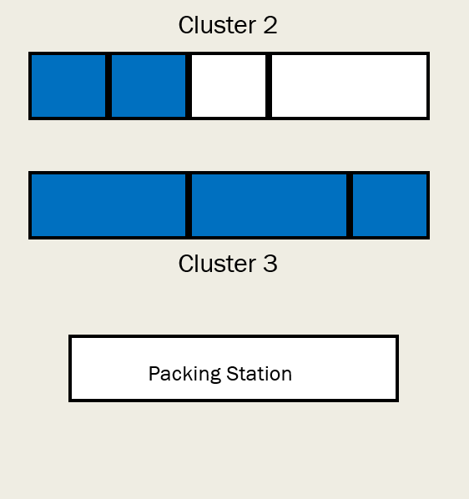
General Warehouse Layout
Cluster 1
Cluster 3
Packing Station

Slide 3
Items To Consider
Cluster 1
$Capacity of shelves, or clusters$
$Size of indiviual shelf spaces, or slots$
$Fractional/Integrailty$ of items

Slide 4
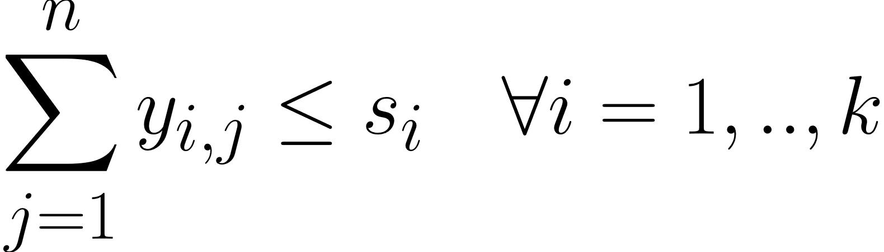
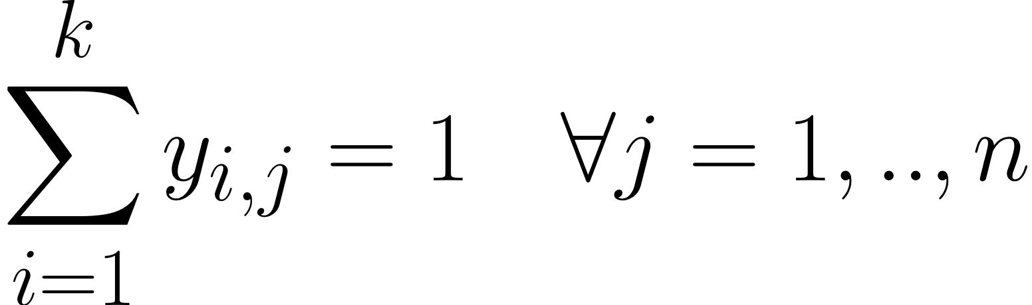
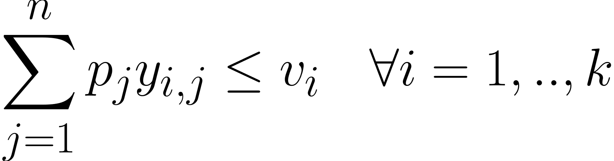
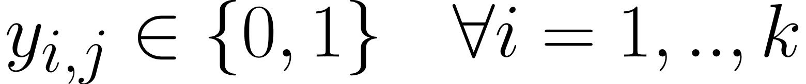
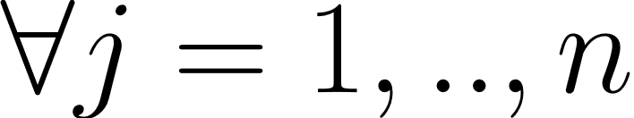
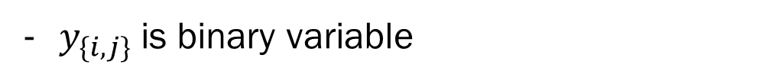
Initial Model
$s_{1}, s_{2},…, s_{n}$ are the upper bounds of items that can be put in a cluster
$y_{\{i,j\}}$is binary variable
$v_{1},v_{2},…,v_{n}$ stores the volume of each cluster
$p_{1},p_{2},…,p_{n}$ to store the volume of each individual item

Slide 5
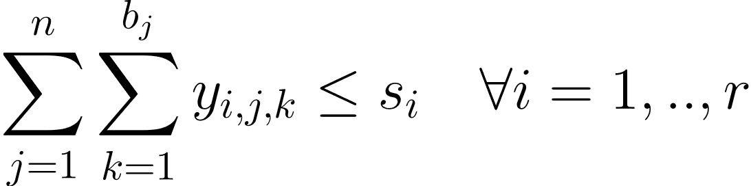
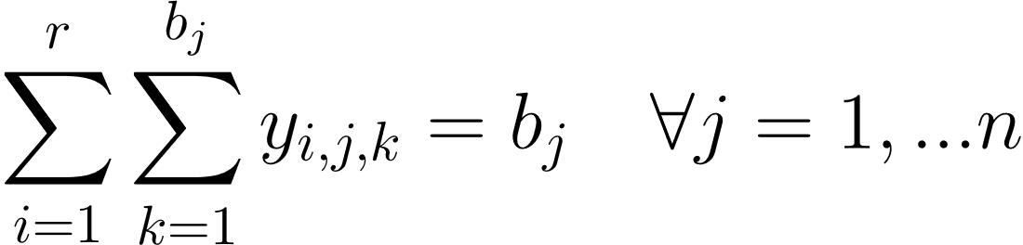

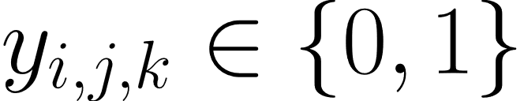
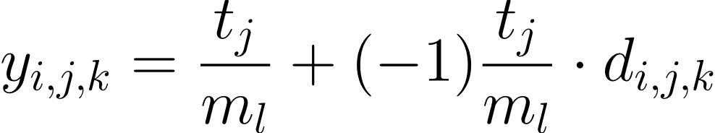




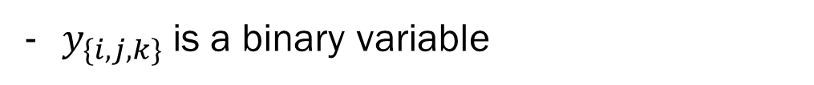
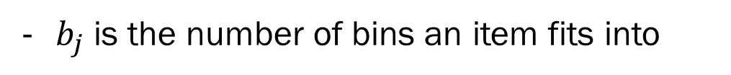
3 Index Model
$s_{1}, s_{2},…, s_{r}$ are the upper bounds of items that can be put in a cluster
$y_{\{i,j,k\}}$is a binary variable
$y_{\{∙,j,∙\}} for large items$
$y_{\{∙,∙,k\}} for small items$
$b_{j}$is the number of bins an item fits into

Slide 6
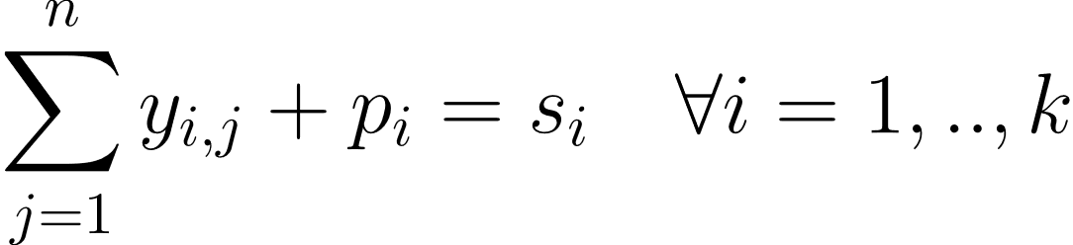
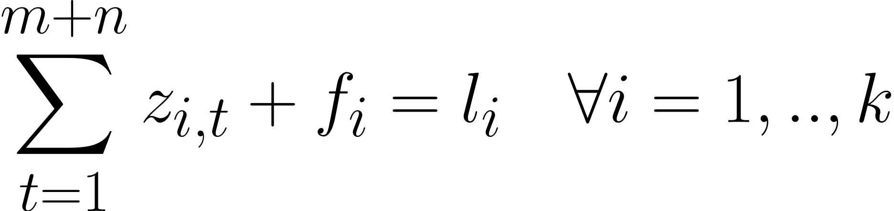
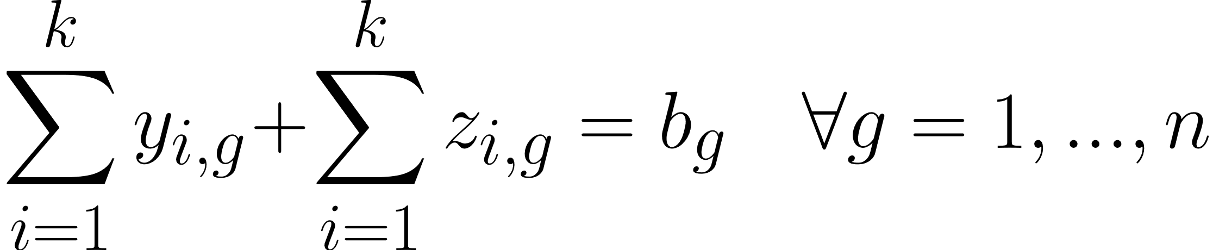
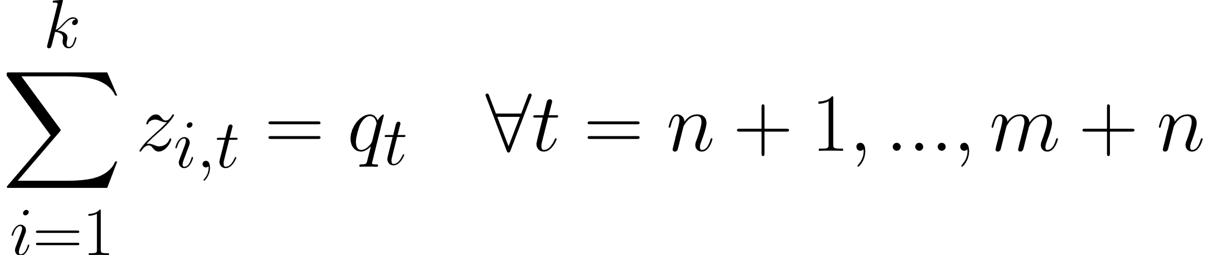
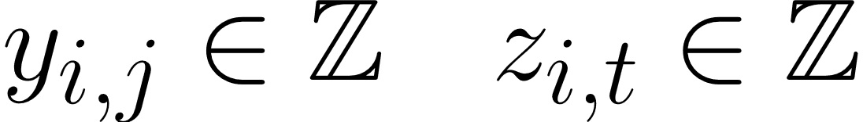
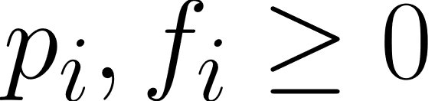
General Formulation

Slide 7
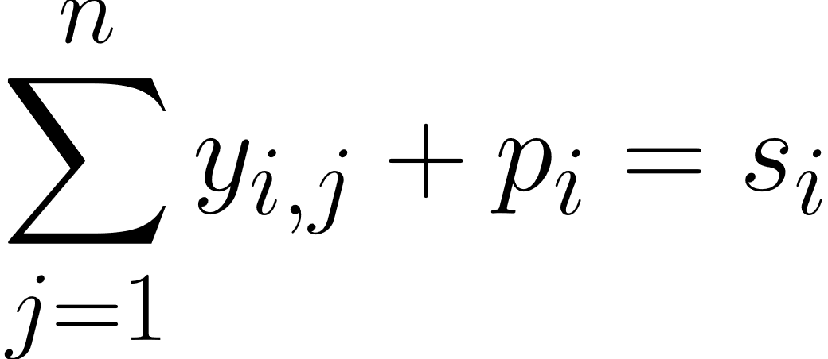
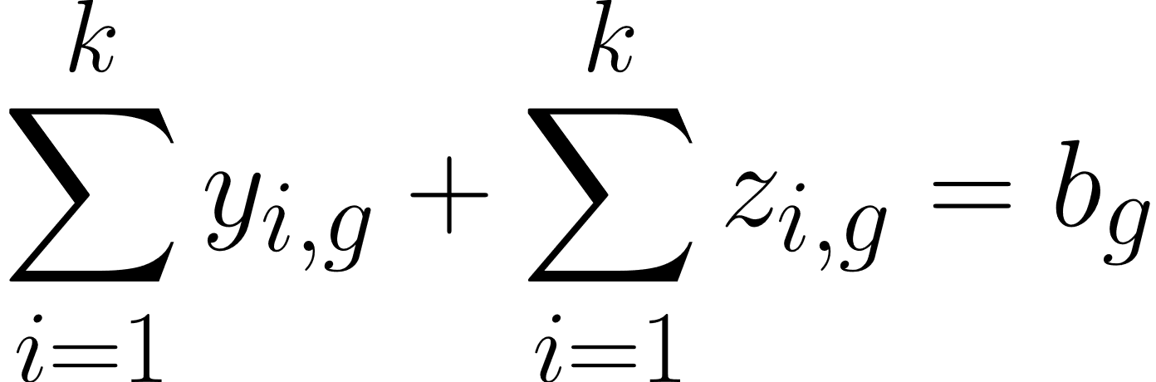
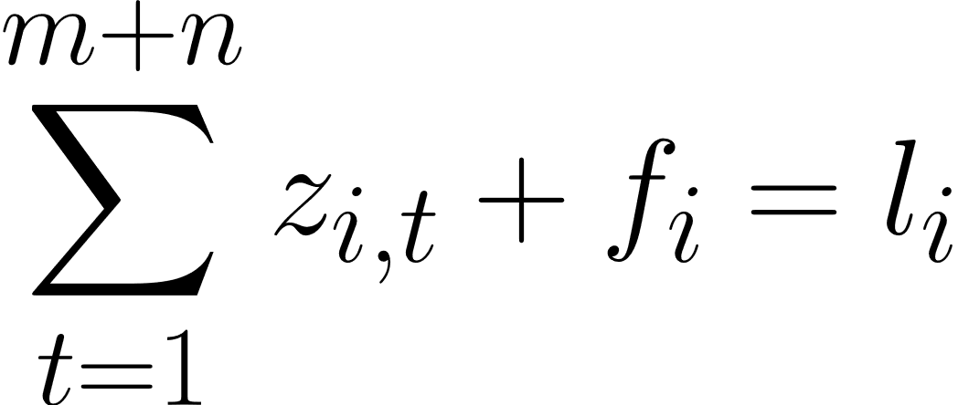
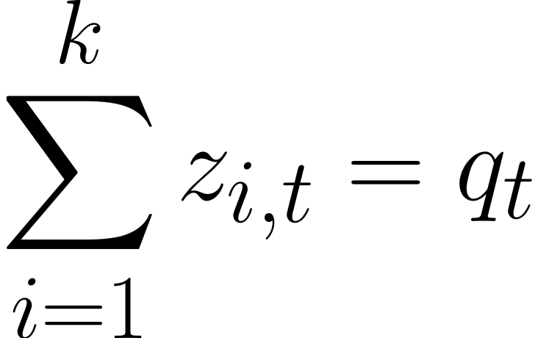








Cluster 2
Item 1
Cluster 1
$$b_{1}$$
$$s_{1}$$
Cluster 3
Item 2
Packing Station
$$l_{1}$$
$$q_{2}$$

Slide 8
General Formulation

Slide 9
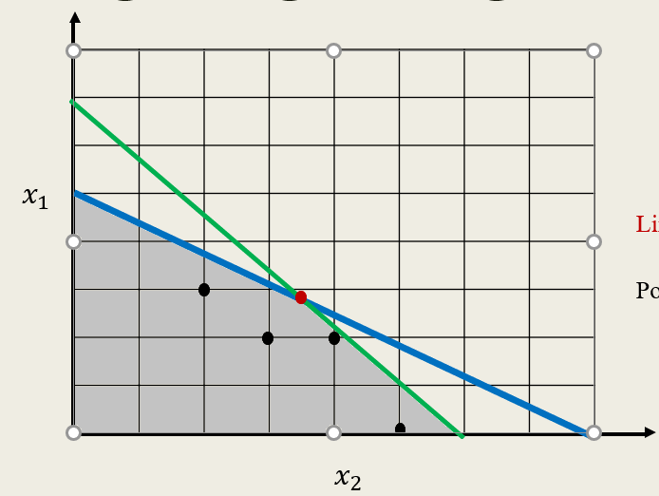


Integer Programming Difficulties
$$x_{1}$$
Linear Optimal Solution
Possible Integer Optimal Solutions
$$x_{2}$$

Slide 10
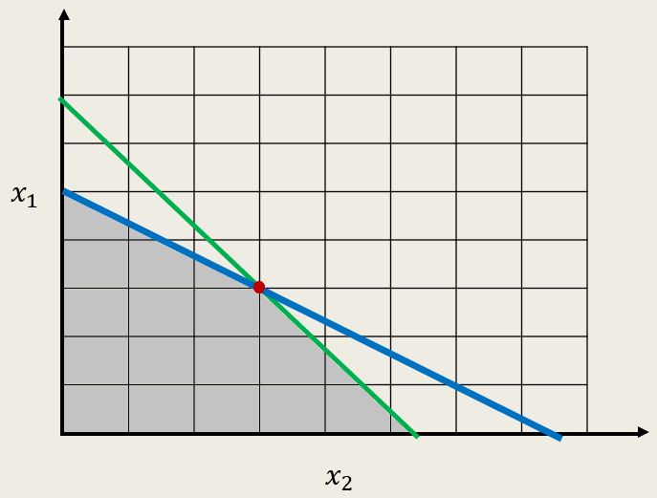
Integrality of Linear Programming
$$x_{1}$$
Possible Linear Optimal Solutions
$$x_{2}$$

Slide 11
Total Unimodularity
Definition: (Unimodular Matrix)- A matrix is “Unimodular" if every one of its upper left square submatrices have determinants of 1, -1, or 0. A matrix is considered “Totally Unimodular" if every square submatrix of the original matrix has a determinant of 1, -1, or 0.

Slide 12
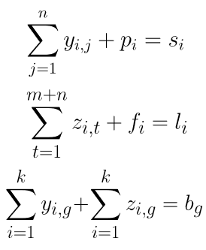
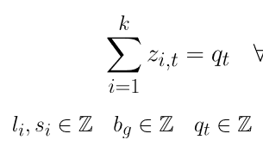
Integrality of Solutions
Proposition 1: There are two conditions for linear models that will imply an integer optimal solution. The first is that the constraint matrix is totally unimodular. The second is that the right-hand side of the constraints will have integral values. [1]

Slide 13
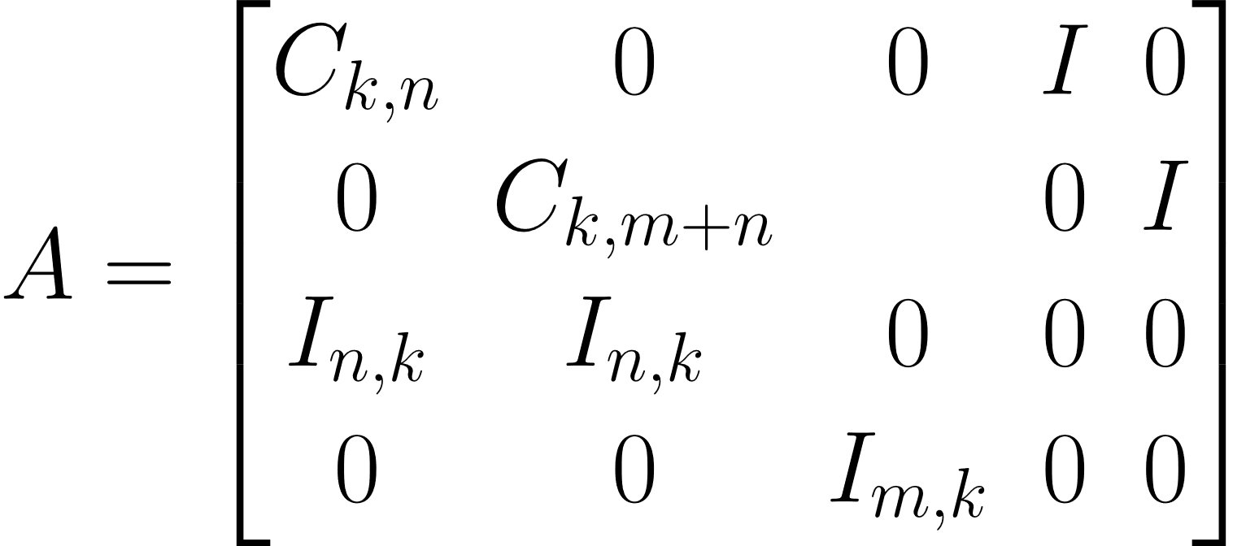

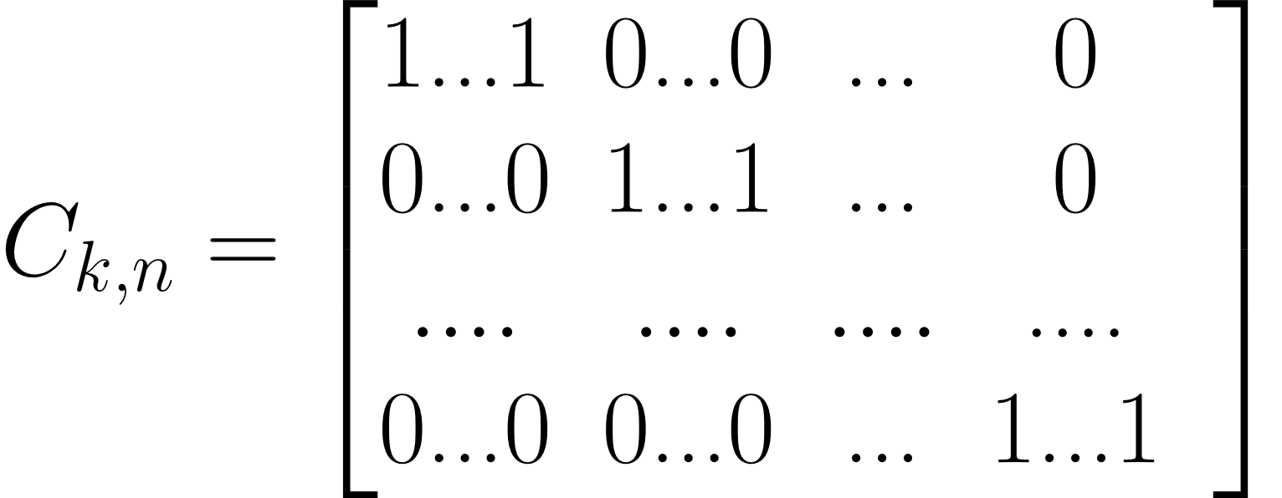
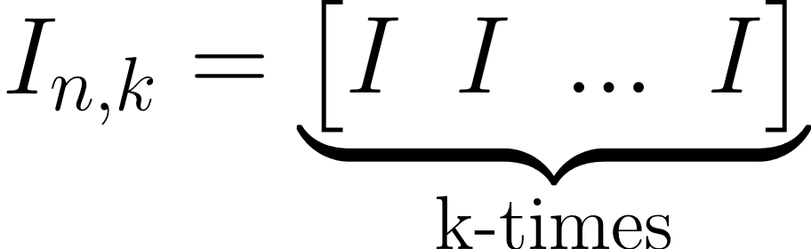
Constraint Matrix

Slide 14
Total Unimodularity Proposition
Proposition 2: A matrix is totally unimodular if no more than two non-zero entries are in each column, and if the rows can be partitioned into two sets such that if a column has two entries of the same sign, their rows are in different sets of the partition. [2]

Slide 15
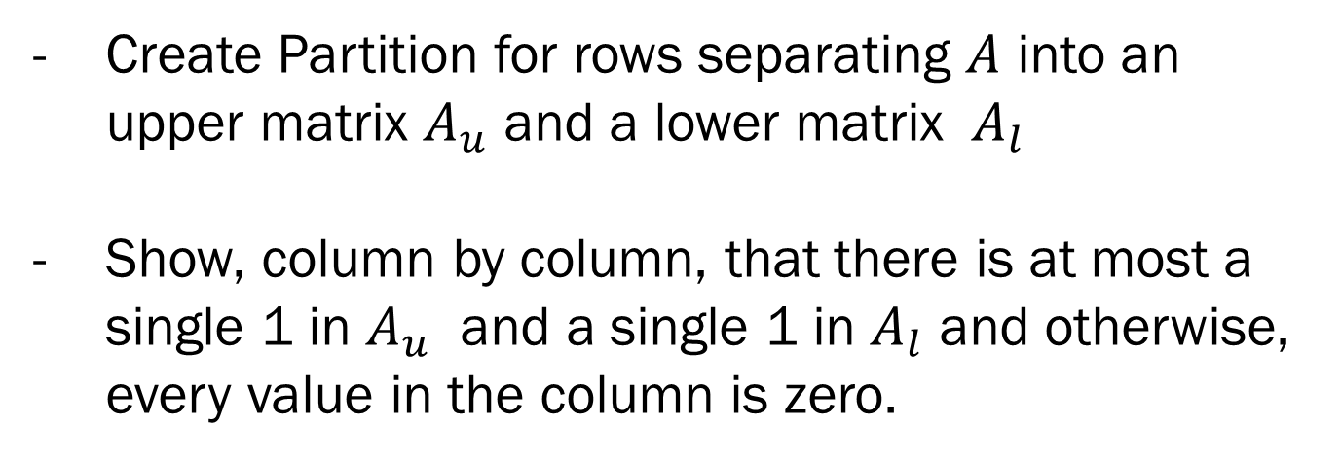
Proof Idea
Create Partition for rows separating $A$ into an upper matrix $A_{u}$ and a lower matrix $A_{l}$
Show, column by column, that there is at most a single 1 in $A_{u}$ and a single 1 in $A_{l}$ and otherwise, every value in the column is zero.

Slide 16


Constraint Matrix
$A_{u}$
$A_{l}$

Slide 17
AMPL Result
ampl: model Ware.mod;
ampl: data Ware.dat;
ampl: solve;
MINOS 5.51: optimal solution found.
1 iterations, objective 9
ampl: display y;
y :=
1 1 1
1 2 1
1 3 1
2 1 0
2 2 1
2 3 0
3 1 0
3 2 0
3 3 0
4 1 0
4 2 0
4 3 0
5 1 0
5 2 0
5 3 0
;
ampl: display z;
z :=
1 1 0
1 2 0
1 3 0
1 4 1
2 1 0
2 2 0
2 3 0
2 4 1
3 1 0
3 2 0
3 3 0
3 4 1
4 1 0
4 2 0
4 3 0
4 4 1
5 1 0
5 2 0
5 3 0
5 4 1
;

Slide 18
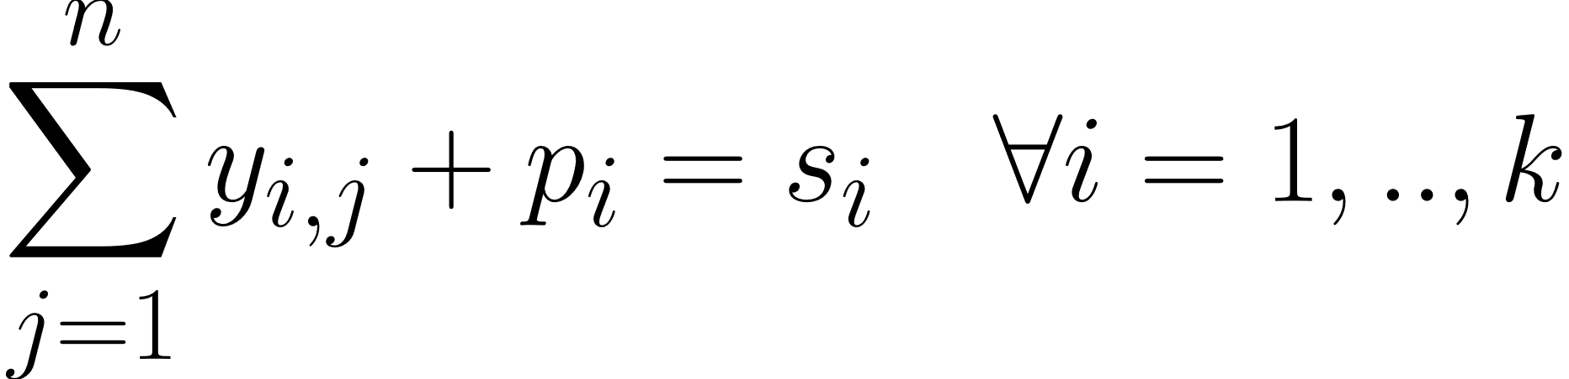
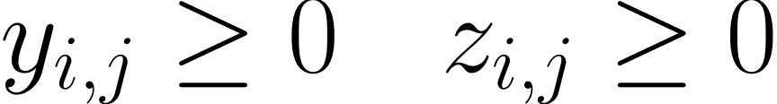
Result

Slide 19
Bibliography
- [1] Cunningham, William H., and Geelen, James F.. “Integral Solutions of Linear Complementarity Problems.” Mathematics of Operations Research, vol. 23, no. 1, 1998, pp. 61–68.
- [2] Chandrasekaran, R. “Total Unimodularity of Matrices.” SIAM Journal on Applied Mathematics, vol. 17, no. 6, 1969, pp. 1032–1034.

